Slide 1
Introduction
Notes:
Schedule: Timing Topic
60 minutes Lecture
60 minutes Total

Slide 2

Oracle9i
Scalability
One
vendor
One management
interface
Reliability
Single development
model
Common
skill sets
Notes:
Oracle9i Features
Oracle offers a comprehensive high-performance infrastructure for e-business. It is called Oracle9i. Oracle9i includes everything needed to develop, deploy, and manage Internet applications.
Benefits include:
Scalability from departments to enterprise e-business sites
Robust, reliable, available, secure architecture
One development model, easy deployment options
Leverage an organization’s current skillset throughout the Oracle platform (including SQL, PL/SQL, Java, and XML)
One management interface for all applications
Industry standard technologies, no proprietary lock-in

Slide 3


Oracle9i
Notes:
Oracle9i
There are two products, Oracle9i Application Server and Oracle9i Database, that provide a complete and simple infrastructure for Internet applications.

Slide 4
Relational and Object Relational Database Management System
Relational model and object relational model
User-defined data types and objects
Fully compatible with relational database
Support of multimedia and large objects
High-quality database server features
Notes:
About the Oracle Server
The Oracle9i server supports both the relational and object relation models.
The Oracle server extends the data modeling capabilities to support an object relational database model that brings object-oriented programming, complex data types, complex business objects, and full compatibility with the relational world.
It includes several features for improved performance and functionality of online transaction processing (OLTP) applications, such as better sharing of run-time data structures, larger buffer caches, and deferrable constraints. Data warehouse applications will benefit from enhancements such as parallel execution of insert, update, and delete operations; partitioning; and parallel-aware query optimization. Operating within the Network Computing Architecture (NCA) framework, Oracle9i supports client-server and Web-based applications that are distributed and multitiered.
Oracle9i can scale tens of thousands of concurrent users, support up to 512 petabytes of data (a petabyte is 1,000 terabytes), and can handle any type of data, including text, spatial, image, sound, video, and time series as well as traditional structured data.
For more information, see Oracle9i Concepts.
Instructor Note
The Object Relation Database Management System features are available with release 8 and higher.
Oracle7 is a relational database management system and Oracle8, 8i, and 9i are object relational database management systems.

Slide 5
System Development Life Cycle
Strategy
and
analysis
Design
Build
and
document
Transition
Production
Notes:
System Development Life Cycle
From concept to production, you can develop a database by using the system development life cycle, which contains multiple stages of development. This top-down, systematic approach to database development transforms business information requirements into an operational database.
Strategy and Analysis
Study and analyze the business requirements. Interview users and managers to identify the information requirements. Incorporate the enterprise and application mission statements as well as any future system specifications.
Build models of the system. Transfer the business narrative into a graphical representation of business information needs and rules. Confirm and refine the model with the analysts and experts.
Design
Design the database based on the model developed in the strategy and analysis phase.
Build and Document
Build the prototype system. Write and execute the commands to create the tables and supporting objects for the database.
Develop user documentation, Help text, and operations manuals to support the use and operation of the system.

Slide 6


Definition of a Relational Database
A relational database is a collection of relations or
two-dimensional tables.
Oracle
server
Table Name: EMPLOYEES
Table Name: DEPARTMENTS
…
…
Notes:
Definition of a Relational Database
A relational database uses relations or two-dimensional tables to store information.
For example, you might want to store information about all the employees in your company. In a relational database, you create several tables to store different pieces of information about your employees, such as an employee table, a department table, and a salary table.

Slide 7
Data Models
Model of
system
in client’s
mind
Entity model of
client’s model
Table model
of entity model
Oracle
server
Tables on disk
Notes:
Data Models
Models are a cornerstone of design. Engineers build a model of a car to work out any details before putting it into production. In the same manner, system designers develop models to explore ideas and improve the understanding of the database design.
Purpose of Models
Models help communicate the concepts in people’s minds. They can be used to do the following:
Communicate
Categorize
Describe
Specify
Investigate
Evolve
Analyze
Imitate
The objective is to produce a model that fits a multitude of these uses, can be understood by an end user, and contains sufficient detail for a developer to build a database system.

Slide 8
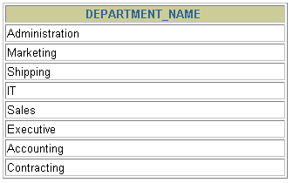
Communicating with a RDBMS
Using SQL
SQL statement
is entered.
Statement is sent to Oracle Server.
SELECT department_name
FROM departments;
Oracle
server
Notes:
Structured Query Language
Using SQL, you can communicate with the Oracle server. SQL has the following advantages:
Efficient
Easy to learn and use
Functionally complete (With SQL, you can define, retrieve, and manipulate data in the tables.)

Slide 9
Relational Database Management System
Oracle
server
User tables
Data
dictionary
Notes:
Relational Database Management System
Oracle provides a flexible RDBMS called Oracle9i. Using its features, you can store and manage data with all the advantages of a relational structure plus PL/SQL, an engine that provides you with the ability to store and execute program units. Oracle9i also supports Java and XML. The Oracle server offers the options of retrieving data based on optimization techniques. It includes security features that control how a database is accessed and used. Other features include consistency and protection of data through locking mechanisms.
The Oracle9i server provides an open, comprehensive, and integrated approach to information management. An Oracle server consists of an Oracle database and an Oracle server instance. Every time a database is started, a system global area (SGA) is allocated, and Oracle background processes are started. The system global area is an area of memory used for database information shared by the database users. The combination of the background processes and memory buffers is called an Oracle instance.

Slide 10
SQL Statements
SELECT
INSERT
UPDATE
DELETE
MERGE
CREATE
ALTER
DROP
RENAME
TRUNCATE
COMMIT
ROLLBACK
SAVEPOINT
GRANT
REVOKE
Data retrieval
Data manipulation language (DML)
Data definition language (DDL)
Transaction control
Data control language (DCL)
Notes:
SQL Statements
Oracle SQL complies with industry-accepted standards. Oracle Corporation ensures future compliance with evolving standards by actively involving key personnel in SQL standards committees. Industry-accepted committees are the American National Standards Institute (ANSI) and the International Standards Organization (ISO). Both ANSI and ISO have accepted SQL as the standard language for relational databases.

Slide 11
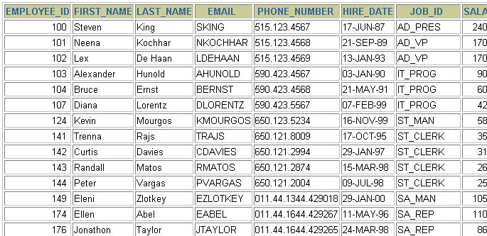
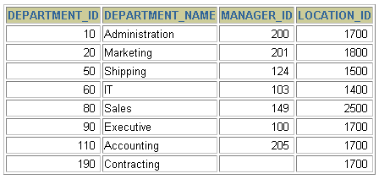
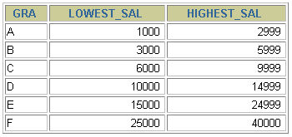
Tables Used in the Course
EMPLOYEES
DEPARTMENTS
JOB_GRADES
Notes:
Tables Used in the Course
The following main tables are used in this course:
EMPLOYEES table, which gives details of all the employees
DEPARTMENTS table, which gives details of all the departments
JOB_GRADES table, which gives details of salaries for various grades
Note: The structure and data for all the tables are provided in Appendix B.
Instructor Note
This course uses the Sample Schema that is shipped with the Oracle9i database. The full Sample Schema consists of several subschemas. One of the subschemas is called HR (Human Resources). This course uses the HR portion of the Sample Schema. Some of the rows from the HR schema are removed to simplify examples in this courseware.
Have the students turn to Appendix B to review the tables used in the course.

